Slide 1

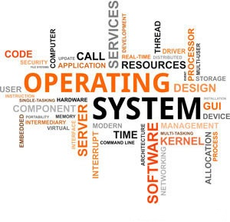

3140702
Operating System
Unit - 2
Process and Thread Management
Prof. Firoz A. Sherasiya
9879879861
firoz.sherasiya@darshan.ac.in

Slide 2
Topics to be covered
Definition of process
Process relationship
Process states
Process state transitions
Process control
Process control block
Context switching
Threads
Concept of multithreads
Benefits of threads
Types of threads

Slide 3
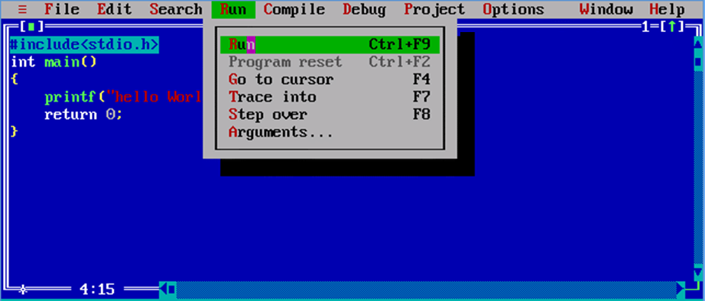
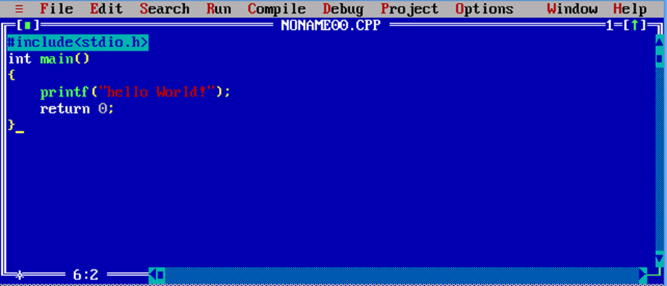
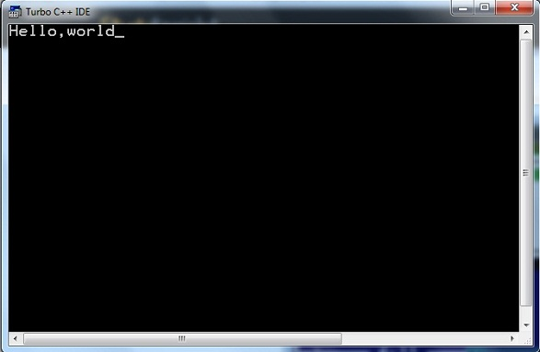
What is Process?
Program
Process

Slide 4
What is Process?
Process is a program under execution.
Process is an abstraction of a running program.
Process is an instance of an executing program, including the current values of the program counter, registers & variables.
Each process has its own virtual CPU.

Slide 5


Multiprogramming
The real CPU switches back and forth from process to process.
This rapid switching back and forth is called multiprogramming.
The number of processes loaded simultaneously in memory is called degree of multiprogramming.

Slide 6
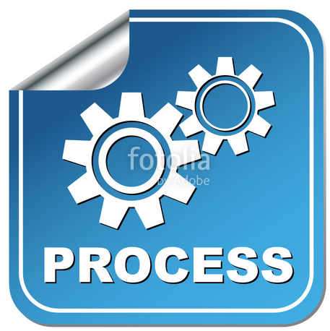
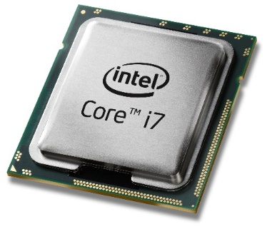
Multiprogramming execution
P1
P2
P3
Memory
There are three processes, one processor (CPU), three logical program counter (one for each processes) in memory and one physical program counter in processor.
Here CPU is free (no process is running).
No data in physical program counter.
Logical
Program Counter
P1
Processor
Logical
Program Counter
Physical
Program Counter
P2
Logical
Program Counter
P3

Slide 7
Multiprogramming execution
P1
P2
P3
Memory
CPU is allocated to process P1 (process P1 is running).
Data of process P1 is copied from its logical program counter to the physical program counter.
Logical
Program Counter
P1
P1
Processor
Logical
Program Counter
Physical
Program Counter
P2
Logical
Program Counter
P3

Slide 8
Multiprogramming execution
P1
P2
P3
Memory
CPU switches from process P1 to process P2.
CPU is allocated to process P2 (process P2 is running).
Data of process P1 is copied back to its logical program counter.
Data of process P2 is copied from its logical program counter to the physical program counter.
Logical
Program Counter
P1
Processor
Logical
Program Counter
P2
Physical
Program Counter
P2
P1
Logical
Program Counter
P3

Slide 9
Multiprogramming execution
P1
P2
P3
Memory
CPU switches from process P2 to process P3.
CPU is allocated to process P3 (process P3 is running).
Data of process P2 is copied back its logical program counter.
Data of process P3 is copied from its logical program counter to the physical program counter.
Logical
Program Counter
P1
Processor
Logical
Program Counter
P2
Physical
Program Counter
P2
P3
Logical
Program Counter
P3

Slide 10
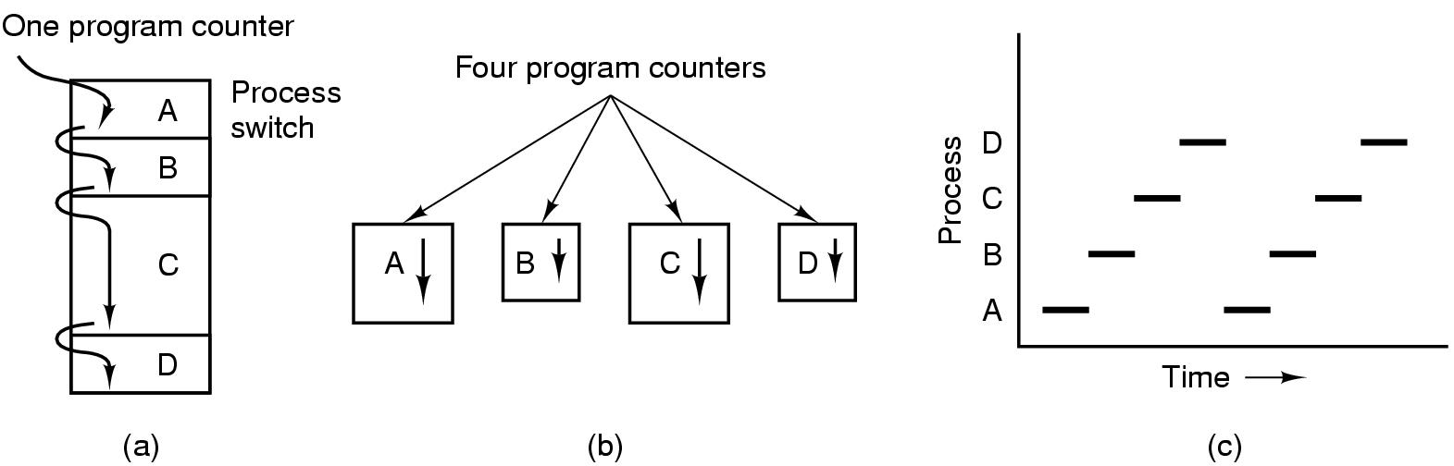
Process Model
Fig. (a) Multiprogramming of four programs in memory
Fig. (b) Conceptual model of 4 independent, sequential processes, each with its own flow of control (i.e., its own logical program counter) and each one running independently of the other ones.
Fig. (c) over a long period of time interval, all the processes have made progress, but at any given instant only one process is actually running.

Slide 11
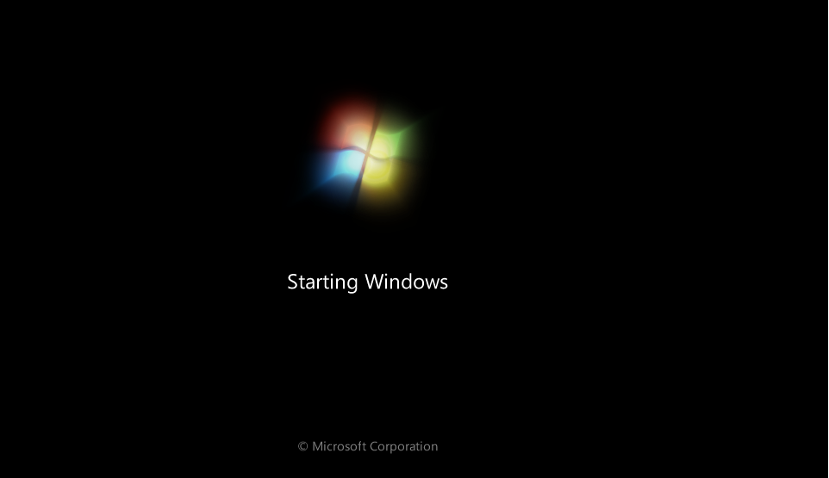
Process Creation
System initialization
At the time of system (OS) booting various processes are created
Foreground and background processes are created
Background process – that do not interact with user e.g. process to accept mail
Foreground Process – that interact with user

Slide 12
Process Creation
Execution of a process creation system call (fork) by running process
Running process will issue system call (fork) to create one or more new process to help it.
A process fetching large amount of data and execute it will create two different processes one for fetching data and another to execute it.
P1
P3
P2

Slide 13
Process Creation (Cont…)
A user request to create a new process
Start process by clicking an icon (opening word file by double click) or by typing command.

Slide 14
Process Creation (Cont…)
Initialization of batch process
Applicable to only batch system found on large mainframe

Slide 15
Process Termination
Normal exit (voluntary)
Terminated because process has done its work.

Slide 16
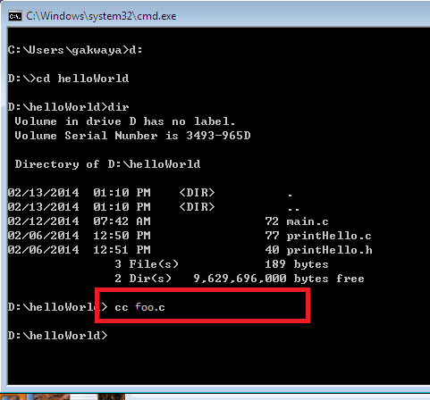

Process Termination
Error exit (voluntary)
The process discovers a fatal error e.g. user types the command cc foo.c to compile the program foo.c and no such file exists, the compiler simply exit.

Slide 17
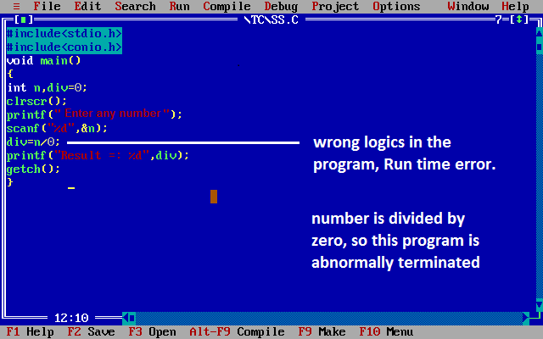
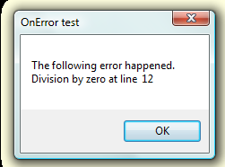
Process Termination
Fatal error (involuntary)
An error caused by a process often due to a program bug e.g. executing an illegal instruction, referencing nonexistent memory or divided by zero.

Slide 18
Process Termination
Killed by another process (involuntary)
A process executes a system call telling the OS to kill some other process using kill system call.

Slide 19
Process Hierarchies
Parent process can create child process, child process can create its own child process.
P1
Parent process
P2
P4
Child process
P3

Slide 20
Process Hierarchies
Parent process can create child process, child process can create its own child process.
UNIX has hierarchy concept which is known as process group
Windows has no concept of hierarchy
All the process as treated equal (use handle concept)
P1
P2
P4
P3
P3
Parent process
P5
P6
P5
P6
Child process

Slide 21

Handle
When a process is created, the parent process is given a special token called handle.
This handle is used to control the child process.
A process is free to pass this token to some other process.
P1
P2
P4
P3

Slide 22
Process State
Running – Process is actually using the CPU
Ready – Process is runnable, temporarily stopped to let another process to run
Blocked – process is unable to run until some external event happens
Running
Blocked
Ready
Processes are always either executing (running) or waiting to execute (ready) or waiting for an event (blocked) to occur.

Slide 23

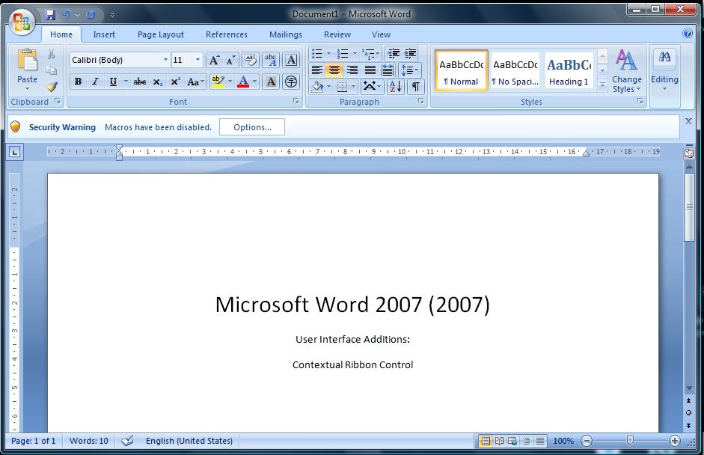

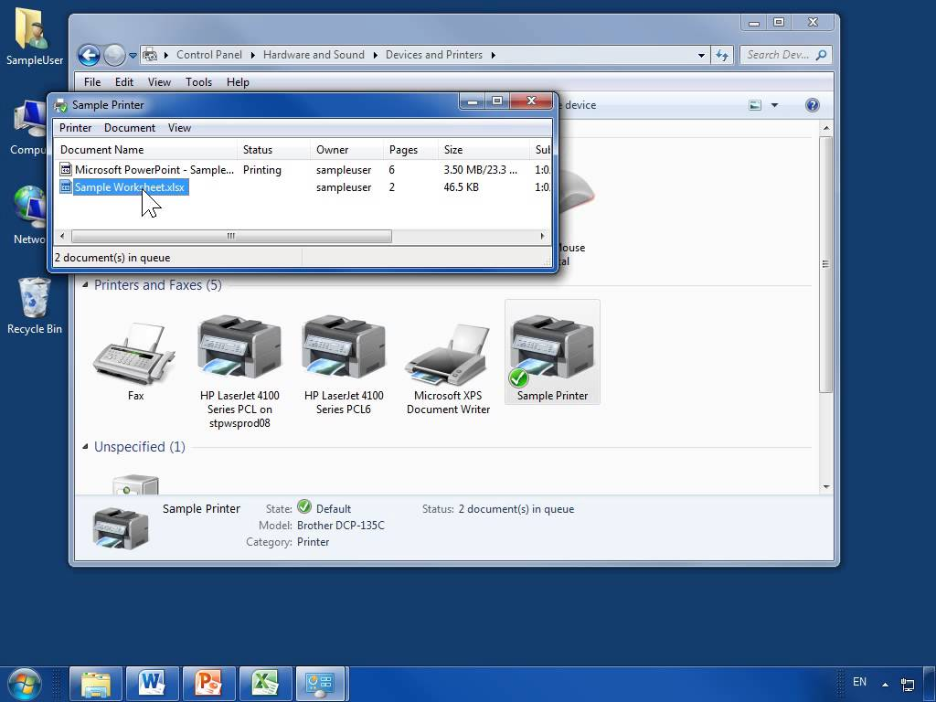
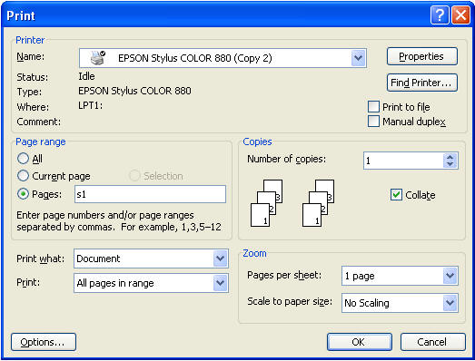

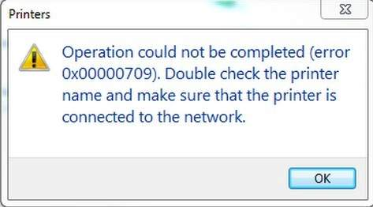
Process State
Blocked
Running
Ready
Running – Process is actually using the CPU
Ready – Process is runnable, temporarily stopped to let another process to run
Blocked – process is unable to run until some external event happens
Processes are always either executing (running), waiting to execute (ready) or waiting for an event (blocked) to occur.
Running
Blocked
Ready

Slide 24
Process State Transitions
When and how these transitions occur (process moves from one state to another)?
Process blocks for input or waits for an event (i.e. printer is not available)
Scheduler picks another process
End of time-slice or
pre-emption.
Scheduler picks this process
Input becomes available, event arrives (i.e. printer become available)
Running
3
1
2
Blocked
Ready
4

Slide 25
Five State Process Model and Transitions
New – process is being created
Ready – process is waiting to run (runnable), temporarily stopped to let another process run
Running – process is actually using the CPU
Blocked – unable to run until some external event happens
Exit (Terminated) – process has finished the execution
Admit
Dispatch
Release
New
Ready
Running
Exit
Time-out
Event
Occurs
Event
Wait
Blocked

Slide 26
Queue Diagram
Process is
Scheduled
to run
Dispatch
Process is
completed
Exit
Ready Queue
Admit
Processor
Time-out
Event Wait
Event
Occurs
Blocked Queue

Slide 27
Process Control Block (PCB)
A Process Control Block (PCB) is a data structure maintained by the operating system for every process.
PCB is used for storing the collection of information about the processes.
The PCB is identified by an integer process ID (PID).
A PCB keeps all the information needed to keep track of a process.

Slide 28
Process Control Block (PCB)
The PCB is maintained for a process throughout its lifetime and is deleted once the process terminates.
The architecture of a PCB is completely dependent on operating system and may contain different information in different operating systems.
PCB lies in kernel memory space.

Slide 29
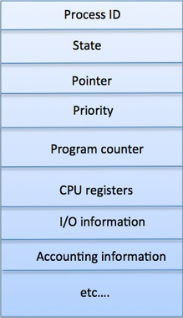
Process Control Block (PCB) contains
Process ID - Unique identification for each of the process in the operating system.
Process State - The current state of the process i.e., whether it is ready, running, waiting.
Pointer - A pointer to parent process.
Priority - Priority of a process.
Program Counter - Program Counter is a pointer to the address of the next instruction to be executed for this process.

Slide 30
Process Control Block (PCB) contains
CPU registers - Various CPU registers where process need to be stored for execution for running state.
IO status information - This includes a list of I/O devices allocated to the process.
Accounting information - This includes the amount of CPU used for process execution, time limits etc.

Slide 31
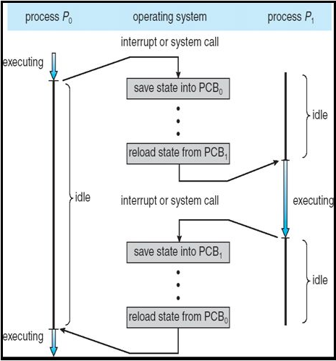
Context switching
Context switch means stopping one process and restarting another process.
When an event occur, the OS saves the state of an active process and restore the state of new process.
Context switching is purely overhead because system does not perform any useful work while context switch.

Slide 32
Steps performed by OS during Context switching
Sequence of action:
OS takes control (through interrupt)
Saves context of running process in the process PCB
Reload context of new process from the new process PCB
Return control to new process

Slide 33
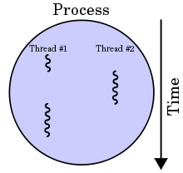

Thread
Thread is light weight process created by a process.
Processes are used to execute large, ‘heavyweight’ jobs such as working in word, while threads are used to carry out smaller or ‘lightweight’ jobs such as auto saving a word document.
Threads

Slide 34
Thread
Thread is light weight process created by a process.
Thread is a single sequence stream within a process.
Thread has it own
program counter that keeps track of which instruction to execute next.
system registers which hold its current working variables.
stack which contains the execution history.

Slide 35
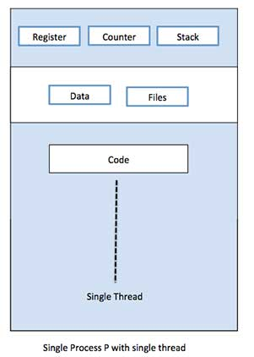
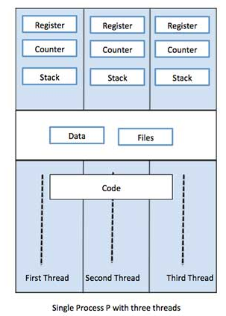
Single Thread VS Multiple Thread

Slide 36
Similarities between Process & Thread
Like processes threads share CPU and only one thread is running at a time.
Like processes threads within a process execute sequentially.
Like processes thread can create childrens.
Like a traditional process, a thread can be in any one of several states: running, blocked, ready or terminated.
Like process threads have Program Counter, Stack, Registers and State.

Slide 37
Dissimilarities between Process & Thread
Unlike processes threads are not independent of one another.
Threads within the same process share an address space.
Unlike processes all threads can access every address in the task.
Unlike processes threads are design to assist one other. Note that processes might or might not assist one another because processes may be originated from different users.

Slide 38
Advantages of Threads
Threads minimize the context switching time.
Use of threads provides concurrency within a process.
Efficient communication.
It is more easy to create and context switch threads.
Threads can execute in parallel on multiprocessors.
With threads, an application can avoid per-process overheads
Thread creation, deletion, switching easier than processes.
Threads have full access to address space (easy sharing).

Slide 39
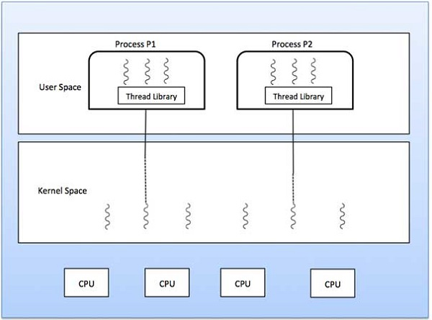
Types of Threads
Kernel Level Thread
User Level Thread
User
Level
Threads
Kernel
Level
Threads

Slide 40
Types of Threads (Cont…)
$$\text{USER} \text{LEVEL} \text{THREAD}$$ | $$\text{KERNEL} \text{LEVEL} \text{THREAD}$$
User thread are implemented by users. | Kernel threads are implemented by OS.
OS doesn’t recognize user level threads. | Kernel threads are recognized by OS.
Implementation of User threads is easy. | Implementation of Kernel thread is complex.
Context switch time is less. | Context switch time is more.
Context switch requires no hardware support. | Context switch requires hardware support.
If one user level thread perform blocking operation then entire process will be blocked. | If one kernel thread perform blocking operation then another thread with in same process can continue execution.
Example : Java thread, POSIX threads. | Example : Window Solaris

Slide 41
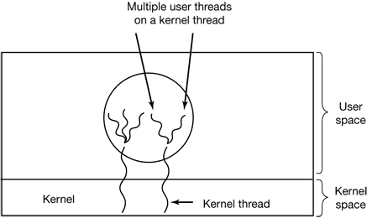
Hybrid Thread
Combines the advantages of user level and kernel level thread.
It uses kernel level thread and then multiplex user level thread on to some or all of kernel threads.
Gives flexibility to programmer that how many kernel level threads to use and how many user level thread to multiplex on each one.
Kernel is aware of only kernel level threads and schedule it.

Slide 42
Multi threading models
One to One Model
Each user threads mapped to one kernel thread.
Problem with this model is that creating a user thread requires the corresponding kernel thread.
Many to One Model
Multiple user threads mapped to one kernel thread.
Problem with this model is that a user thread can block entire process because we have only one kernel thread.
Many to Many Model
Multiple user threads multiplex to more than one kernel threads.
Advantage with this model is that a user thread can not block entire process because we have multiple kernel thread.

Slide 43
Pthread function calls
Pthread_create:- Create a new thread
Pthread_exit:- Terminate the calling thread
Pthread_join:- Wait for a specific thread to exit
Pthread_yield:- Release the CPU to let another thread run
Pthread_attr_init:- Create and initialize a thread’s attribute structure
Pthread_destroy:- Remove a thread’s attribute structure

Slide 44
System calls
A system call is the programmatic way in which a computer program requests a service from the kernel of the operating system it is executed on.
A system call is a way for programs to interact with the operating system.
A computer program makes a system call when it makes a request to the operating system’s kernel.
System call provides the services of the operating system to the user programs via Application Program Interface(API).
It provides an interface between a process and operating system to allow user-level processes to request services of the operating system.
System calls are the only entry points into the kernel system.
All programs needing resources must use system calls.

Slide 45
System calls
ps (process status):- The ps (process status) command is used to provide information about the currently running processes, including their process identification numbers (PIDs).
fork:- Fork system call is used for creating a new process, which is called child process, which runs concurrently with the process that makes the fork() call (parent process).
wait:- Wait system call blocks the calling process until one of its child processes exits or a signal is received. After child process terminates, parent continues its execution after wait system call instruction.
exit:- Exit system call terminates the running process normally.
exec family:- The exec family of functions replaces the current running process with a new process.

Slide 46
Questions asked in GTU
Explain Process/Thread Life Cycle with diagram.
Explain process control block (PCB) with diagram.
Difference between process and thread.
Write various multi threading models.
Write benefits of threads.

Slide 47


